Slide 1
Media Kit
THERE’S A STORY TO BE TOLD HERE
Media Kit

Slide 2
Why Radio Humber?
Why Radio Humber?
Our focus is serving our local community.
We form personal relationships and build trust with our listeners.
We connect listeners to advertisers.
THERE’S A STORY TO BE TOLD HERE

Slide 3
Short-Term Benefit
Short-Term Benefit
Local Awareness
Diverse Pool of Listeners
New Customers
Local Popularity
Cost-Effective
THERE’S A STORY TO BE TOLD HERE

Slide 4
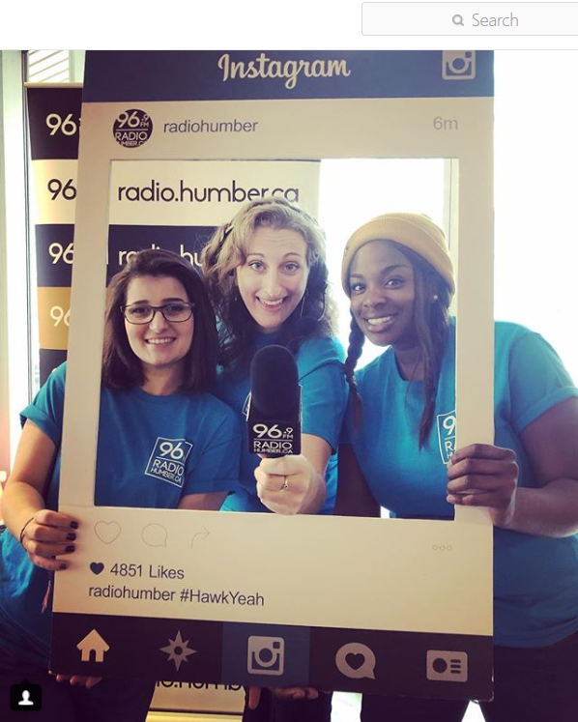
Long-Term Benefit
Long-Term Benefit
Customer Loyalty
Network of Customers
Audience is Always Growing
THERE’S A STORY TO BE TOLD HERE

Slide 5
Advertising Samples
Advertising Samples
THERE’S A STORY TO BE TOLD HERE

Slide 6
Shows
Shows
Cross Talk
@Humber
Humber College radio professor Paul Cross analyzes issues within Radio and mass media.
An award-winning news magazine show written, hosted and produced by Radio and Journalism students
Unsigned
Humber Hawks
An interview and live performance series featuring local musicians, created entirely by radio students.
Radio students deliver live play-by-play coverage of the college sports teams.
This is just a taste of some of our unique programming!
THERE’S A STORY TO BE TOLD HERE

Slide 7
Radio Humber in the Community
Radio Humber in the Community
Plus, Digital Dreams, Canadian Music Week, and Bestival!
THERE’S A STORY TO BE TOLD HERE

Slide 8
Our Listener
Our Listener
Majority of students aged
18 – 34
53%
47%
Over 50,000 full-time, part-time and continuing education students coming from over 100 different countries
Outside the College
Inside the College
Outside the College
Inside the College
Commuters on highways 401, 407, 410, and 427
Surrounding areas in Etobicoke, Mississauga & Brampton
Wide variety of listeners – Both students and faculty are exposed to Radio Humber at all three Humber campuses!

Slide 9
About Our Listener
About Our Listener
Most of our audience has at least some level of career goals
Audience must see inherent value with not very much disposable income
$
Diversity in regards to audience being single or married, with or without kids
Many of our listeners are living with parents, partners or kids, or on college residence
Heavy influence on listeners by social media, making online activity very effective
Unique, fresh and creative content highly appeals to our audience
THERE’S A STORY TO BE TOLD HERE

Slide 10
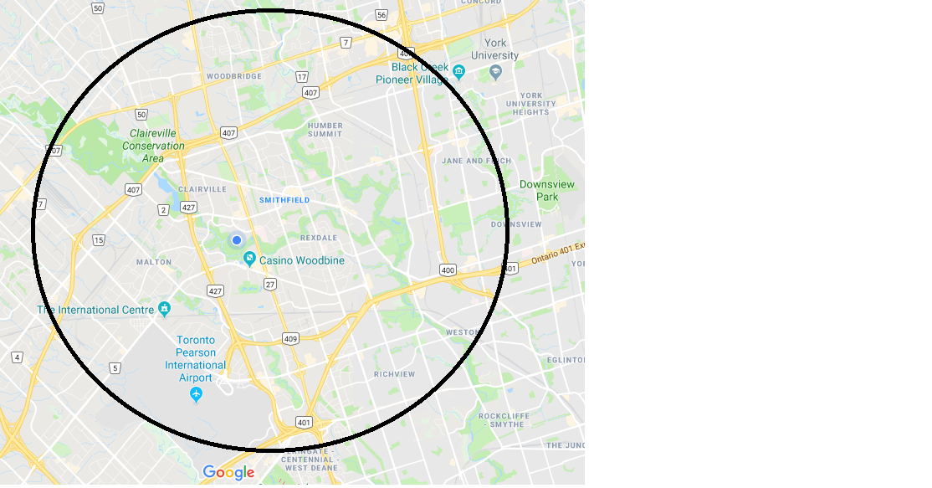
Coverage Area
Coverage Area
THERE’S A STORY TO BE TOLD HERE

Slide 11
About Us
About Us
96.9 CKHC
We are a community radio station.
We bring people together
And make a home in the hearts and minds of the community around us.
96.9 Radio Humber
THERE’S A STORY TO BE TOLD HERE

Slide 12
Radio Humber Online
Radio Humber Online
Facebook:
Over 1,100 Likes and Followers
Almost 3,000 Monthly Impressions
53% Male, 47% Female
Instagram:
Over 2,100 Followers
Over 4,000 Monthly Impressions
51% Male, 49% Female
Twitter:
Over 3,100 Followers
Over 27,000 Monthly Impressions
53% Male, 47% Female
Radio.Humber.ca:
Monthly Page Views
54% Male, 46% Female
11,996 Monthly Impressions

Slide 13
Advertising & Contact Info
Advertising & Contact Info
Our Contact Information:
For program inquiries: Noah Scanga, Programming Assistant noah.scanga@humber.ca or 416 675 6622 ext. 4153
For music inquiries: radiohumber969@gmail.com
For promotions and marketing inquires: Kylee Winn, Promotions Coordinator kylee.winn-thurrott@humber.ca
For other inquiries: Dean Sinclair, General Manager Dean.Sinclair@Humber.ca or 416-675-6622 ext. 5603
FREQUENCY DISCOUNTS (Per Occasion) | PRICES
1 – 200 | $17
201 – 500 | $13
501 – 750 | $11
1 – 200 | $27
201 – 500 | $23
501 – 750 | $19
30 Seconds
60 Seconds
Radio Humber 96.9 FM - CKHC
205 Humber College Boulevard
Toronto, Ontario, Canada, M9W 5L7
THERE’S A STORY TO BE TOLD HERE

Slide 14
Proudly created by Rainer Pluckebaum, Omar Qaqish and Spencer Seymour

